Slide 1

AI BASED CLOUD RESOURCE OPTIMIZER
Humble Hackers (Thiagarajar College of Engineering)
JOVIN J (Team Lead)
SOUNDAR ARUNACHALAM R M (Backend)
SUHAS K S (Frontend)
ASWINKUMAR I (Backend)

Slide 2

1. PROBLEM STATEMENT
Cloud infrastructure faces inefficient resource utilization due to:
Unpredictable demand fluctuations
Over-provisioning and under-utilization of resources
High operational costs
Impact:
Increased costs
Poor user experience during high traffic
Inefficient load balancing

Slide 3

2. OBJECTIVE
Develop an AI-based system to dynamically optimize cloud resources by:
Predicting demand patterns using historical data
Automatically scaling resources based on real-time analysis
Reducing cost while maintaining performance
Suggesting best cloud provider for the application

Slide 4


3. TECHNOLOGY STACK
Backend: Python (Flask/FastAPI) + ARIMA for AI models
Frontend: React.js, tsx for UI
AI/ML: Scikit-learn (ARIMA)
Data Analytics: Pandas, NumPy, Seaborn, Matplotlib
Cloud Platforms: AWS (Simulation)
Database: BigQuery (Proposed)

Slide 5
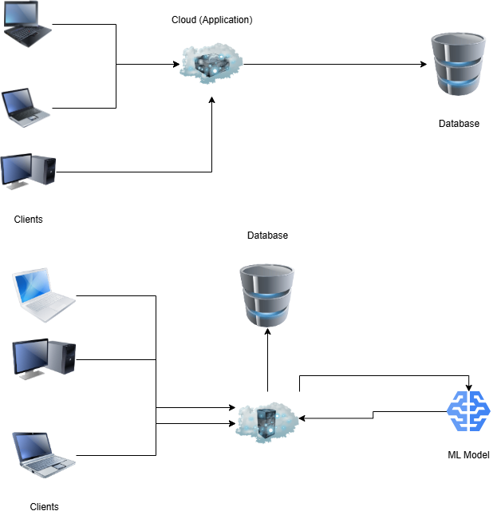
4. WORKFLOW

Slide 6

5. DATA AND ANALYSIS
Data Sources:
Collected from a local python script that connects to the VM using SSH
Historical records of CPU, memory, disk usage, and network traffic are collected for a year (synthetic for now)
Time-based data categorized by hour, day, week, and month
Goal:
Identify high-load patterns
Predict demand spikes and scale automatically
Reduce costs by efficient resource allocation

Slide 7

6. SOLUTION OVERVIEW
AI-based Auto-Scaling:
Use a ARIMA model demand based on historical data
Real-time analysis for resource adjustment
Decision-making based on correlation between usage patterns and traffic load
Key Factors Analyzed:
Day of the week
Time of day (peak vs off-peak hours)
Seasonal trends (monthly and weekly patterns)
Type of workload (network-heavy, CPU-heavy, memory-heavy)

Slide 8
7. IMPLEMENTATION
Data Pipeline:
Collect real-time cloud metrics (SSH)
Pre-process and clean data
Analyze correlation between demand and resource usage
Train AI model using the data
Predict demand and auto-scale resources using the model
Scaling Approach:
If CPU usage > 80% → Add instances
If CPU usage < 30% → Remove instances

Slide 9
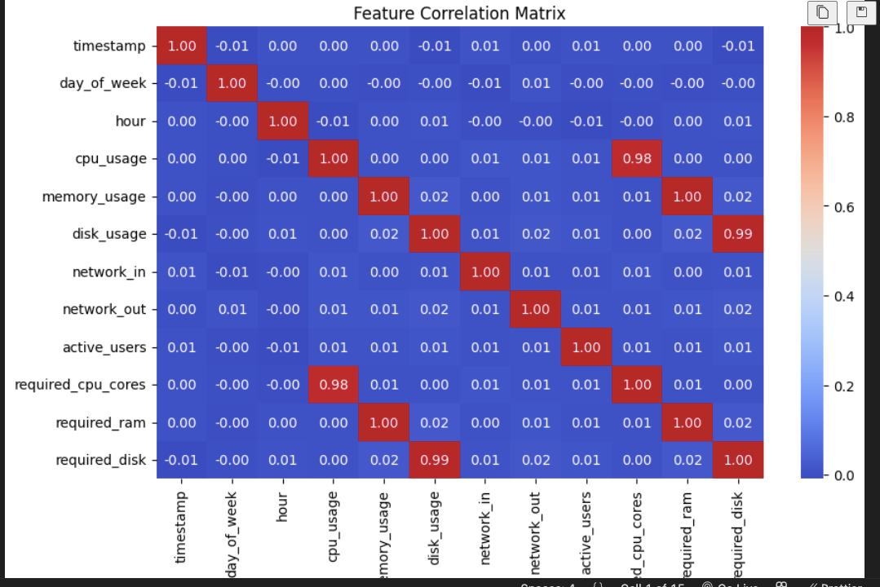
7. VISUALIZATION

Slide 10
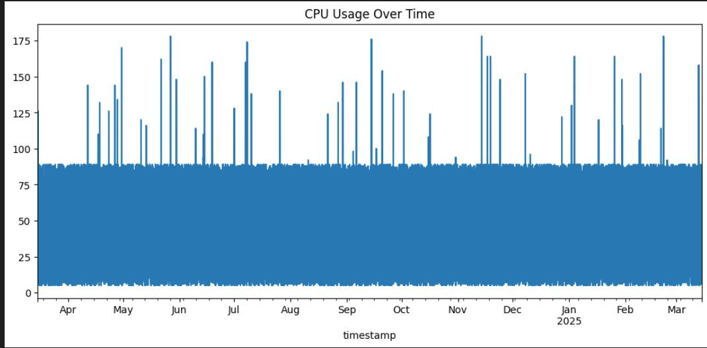
7. VISUALIZATION

Slide 11
8. USER INTERACTION
User can:
View real-time usage patterns
Adjust scaling preferences
Generate usage reports
See suggestions for better usage

Slide 12

9. CHALLENGES AND FUTURE SCOPE
Challenges:
High latency during real-time prediction
Data inconsistency across different cloud platforms
Optimizing cost without compromising performance
Future Scope:
Multi-cloud compatibility
Improved AI model for real-time adjustments
Enhanced security for sensitive data
Impemented of actual data instead of synthetic data

Slide 13
THANK YOU!
Any Questions?

